Slide 1
RECURSIVE ALGORITHM
ALGORITHM ANALYSIS
<<professor>>
Computer Science Department

Slide 2
INTRODUCTION
In C, C++ and Java, any function can call another function.
A function can even call itself.
When a function call itself, it is making a recursive call.
Recursive Call
  A function call in which the function being called is the same as the one making the call.
Recursion is a powerful technique that can be used in the place of iteration(looping).
Recursion
  Recursion is a programming technique in which procedures and functions call themselves.
Computer Science Department
Slide <number> of 16

Slide 3
RECURSIVE ALGORITHM
Definition
  An algorithm that calls itself
Approach
  Solve small problem directly
  Simplify large problem into 1 or more smaller subproblem(s) & solve recursively
  Calculate solution from solution(s) for subproblem
Computer Science Department
Slide <number> of 16

Slide 4
RECURSIVE DEFINITION
A definition in which something is defined in terms of smaller versions of itself.
To do recursion we should know the followings
  BASE CASE:
    The case for which the solution can be stated non-recursively
    The case for which the answer is explicitly known.
  GENERAL CASE:
    The case for which the solution is expressed in smaller version of itself. Also known as recursive case.
Computer Science Department
Slide <number> of 16

Slide 5

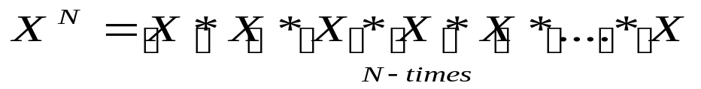
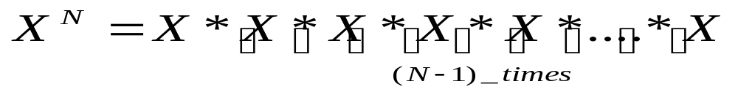
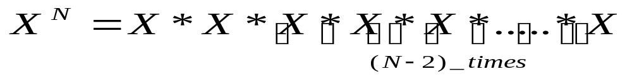

EXAMPLE 1
Can write a function called power that calculates the result of raising an integer to a positive power. If X is an integer and N is a positive integer, the formula for is
Can also write this formula as
Also as
In fact, able to write this formula as
Computer Science Department
Slide <number> of 16

Slide 6





Example 1(Recursive Power Function)
Now lets suppose that X=3 and N=4
Now we can simplify the above equation as
So the base case in this equation is
int Power ( int x , int n )
{
if ( n == 1 )
return x; //Base case
else
return x * Power (x, n-1);
// recursive call
}
Computer Science Department
Slide <number> of 16

Slide 7
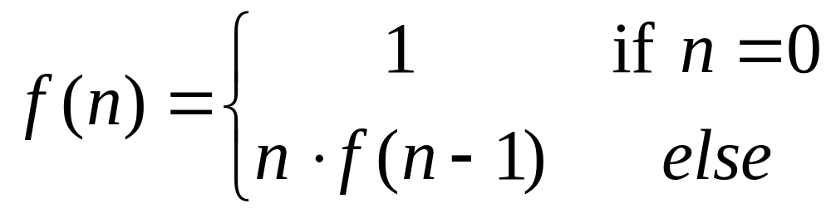
Example 2 (Recursive Factorial Function)
Factorial Function:
Given a positive integer n, n factorial is defined as the product of all integers between 1 and n, including n.
So we can write factorial function mathematically as
Computer Science Department
Slide <number> of 16

Slide 8
Example 2 (Recursive Factorial Function)
Factorial definition
  n! = n × n-1 × n-2 × n-3 × … × 3 × 2 × 1
  0! = 1
To calculate factorial of n
  Base case
    If n = 0, return 1
  Recursive step
    Calculate the factorial of n-1
    Return n × (the factorial of n-1)
Computer Science Department
Slide <number> of 16

Slide 9
Example 2 (Recursive Factorial Function)
int factorial(n)
{
if(n == 0) //Base Case
return 1;
else
return n * factorial(n-1); //Recursion
}
Computer Science Department
Slide <number> of 16

Slide 10
EVALUATION OF FACTORIAL EXAMPLE
  To evaluate Factorial(3)
  evaluate 3 * Factorial(2)
  To evaluate Factorial(2)
  evaluate 2 * Factorial(1)
  To evaluate Factorial(1)
  evaluate 1 * Factorial(0)
  Factorial(0) is 1
  Return 1
  Evaluate 1 * 1
  Return 1
  Evaluate 2 * 1
  Return 2
  Evaluate 3 * 2
  Return 6
Computer Science Department
Slide <number> of 16

Slide 11
RECURSIVE PROGRAMMING
main
factorial(3)
return 6
factorial(3)
3 * factorial(2)
return 2
factorial(2)
2*factorial(1)
return 1
factorial(1)
1*factorial(0)
return 1
factorial(0)
Computer Science Department
Slide <number> of 16

Slide 12
RULES FOR RECURSIVE FUNCTION
In recursion, it is essential for a function to call itself, otherwise recursion will not take place.
Only user define function can be involved in recursion.
To stop the recursive function it is necessary to base the recursion on test condition and proper terminating statement such as exit() or return must be written using if() statement.
Computer Science Department
Slide <number> of 16

Slide 13
RULES FOR RECURSIVE FUNCTION
4. When a recursive function is executed, the recursive calls are not implemented instantly. All the recursive calls are pushed onto the stack until the terminating condition is not detected, the recursive calls stored in the stack are popped and executed.
5. During recursion, at each recursive call new memory is allocated to all the local variables of the recursive functions with the same name.
Computer Science Department
Slide <number> of 16

Slide 14
The Runtime Stack during Recursion
To understand how recursion works at run time, it need to understand what happens when a function is called.
Whenever a function is called, a block of memory is allocated to it in a run-time structure called the stack.
This block of memory will contain
  the function’s local variables,
  local copies of the function’s call-by-value parameters,
  pointers to its call-by-reference parameters, and
  a return address, in other words where in the program the function was called from. When the function finishes, the program will continue to execute from that point.
Computer Science Department
Slide <number> of 16

Slide 15
SEATWORK
The problem of computing the sum of all the numbers between 1 and any positive integer N can be recursively defined.
Computer Science Department
Slide <number> of 16

Slide 16
Exercise
int sum(int n)
{
if(n==1)
return n;
else
return n + sum(n-1);
}

Slide 17

Computer Science Department
Slide 16 of 16
Computer Science Department

